Slide 1
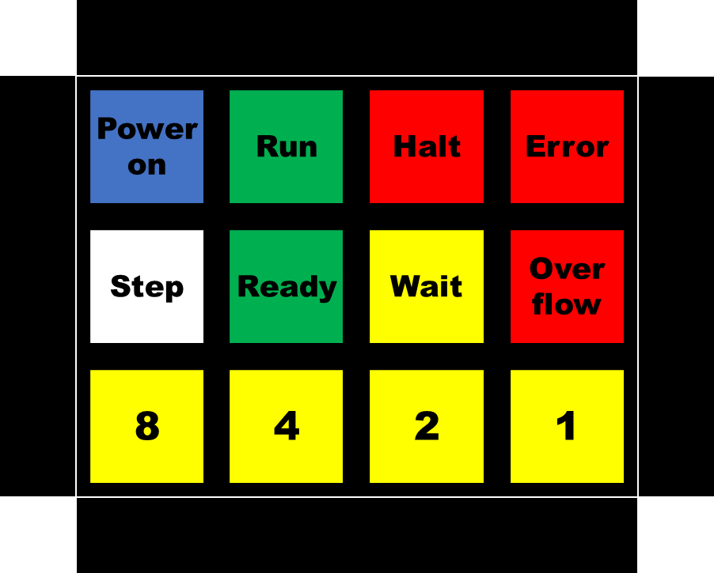
Procedure paper cover:
Enter/adjust text
Adjust colors (in the background shape)
Copy entire cover
Paste as picture
Resize to 64%
Flip the picture horizontally
Print
Check size and eventually adjust the 64%
Cut out the shape
Place cover on the ULU, text down
ULU.42 Status light paper cover template
Power on
Run
Halt
Error
Step
Ready
Wait
Over flow
8
4
2
1

Slide 2
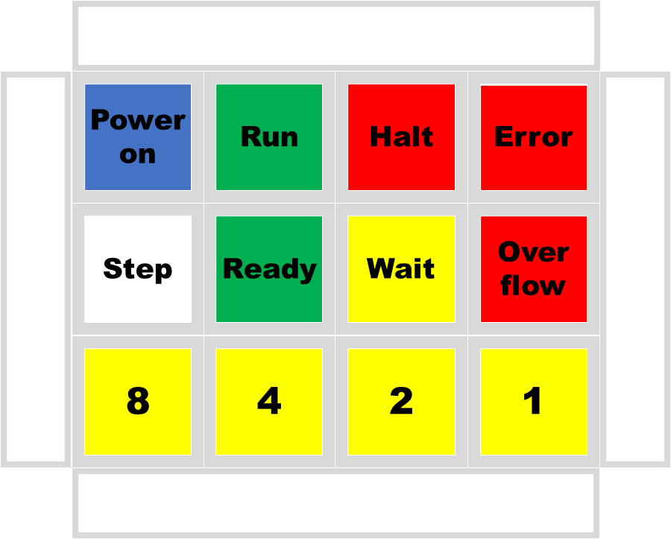
Procedure paper cover:
Enter/adjust text
Adjust colors (background shape)
Copy entire cover
Paste as picture
Resize to 64%
Flip horizontally
Print
Check size and eventually adjust the 64%
Cut out the shape
Place cover on the ULU, text down
Power on
Run
Halt
Error
Step
Ready
Wait
Over flow
8
4
2
1

